Slide 1



SWIGGY DATA ANALYSIS
Presented By:
Mayank Rai
Anish Katoch
Yasmeen Ustad
Akash Phatangare

Slide 2
PROJECT AIM
We have observed a trend towards remote kitchens in recent times, and as a data analyst, our task is to identify the best location for a remote kitchen or a restaurant based on the demand for different types of cuisines in the area. Our objective is to maximize customer satisfaction by providing high-demand cuisines while minimizing delivery time and costs.

Slide 3

OBJECTIVES OF THE PROJECT
Utilized web scraping techniques to gather data from Swiggy's website and presented it in tabular form, precisely defining column details for clarity.
1
By analyzing historical order data, determined the favorite cuisines and the area's demographics and preferences, factoring in customer demand, delivery times, and costs.
2
3
Extracted insights and generated visualizations/dashboards to effectively present the data

Slide 4

STEP 3
INSIGHTS

Slide 5
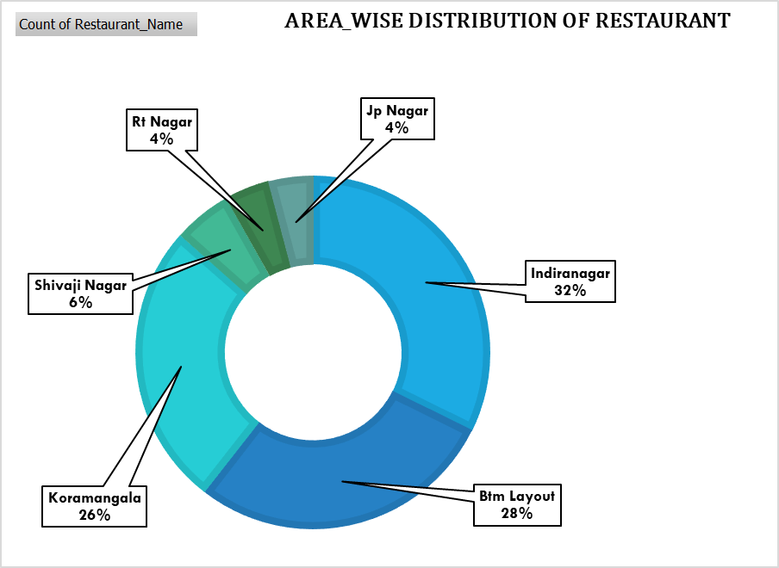
AREA WISE DISTRIBUTION OF RESTAURANTS
Maximum Restaurant Occupancy in Bangalore.
•Indiranagar 24%
• Btm Layout 21%
•Koramangala 20%

Slide 6
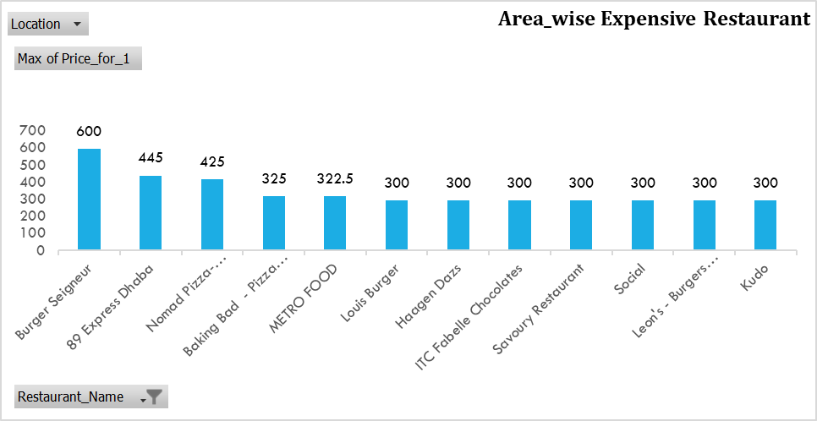
AREA WISE EXPENSIVE RESTAURANT
Type of Writing Done
1. Burger Seigneur 2. 89 Express Dhaba 3. Nomad Pizza

Slide 7
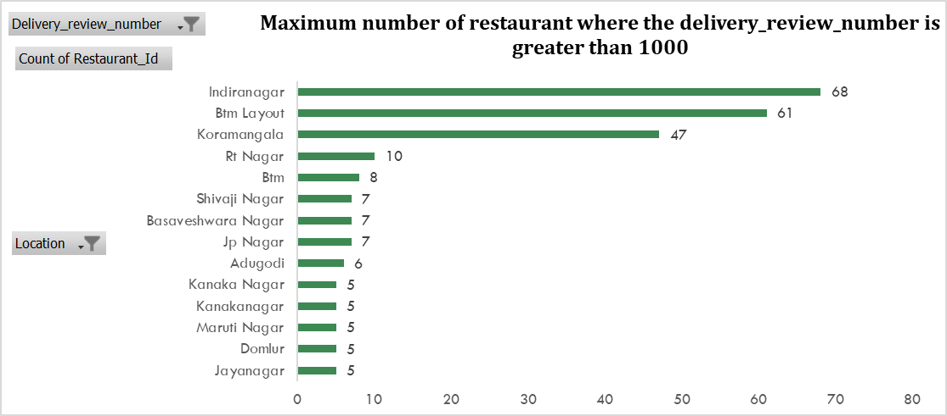
MAXIMUM NO OF RESTAURANT WHERE THE DELIVERY REVIEW NUMBER IS GREATER THAN 1000

Slide 8
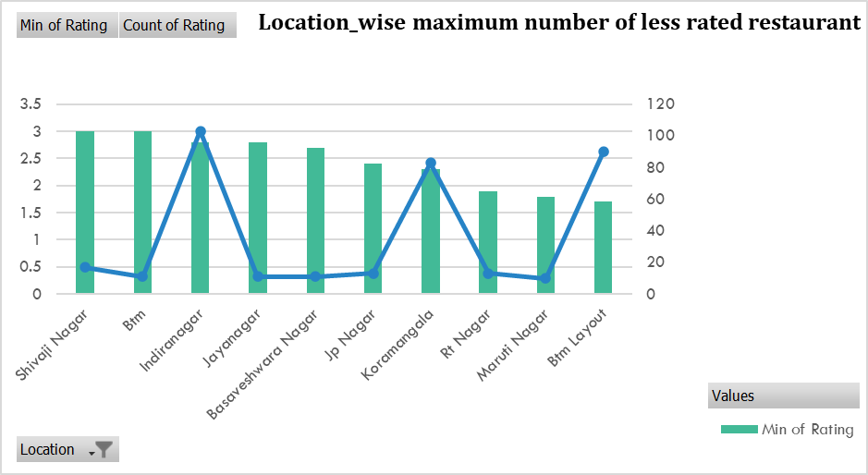
LOCATION WISE MAXIMUM NUMBER OF LESS RATED RESTAURANT
Type of Writing Done
Indiranagar:- (2.8,103) Btm Layout:- (1.7,90) Koramangala:- (2.3,83)

Slide 9
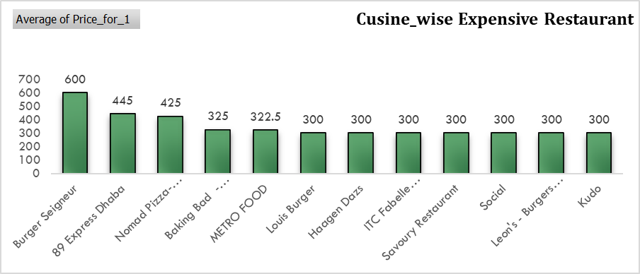
CUSINE_WISE EXPENSIVE RESTAURANT
1. Burger Seigneur 2. 89 Express Dhaba 3. Nomad Pizza

Slide 10
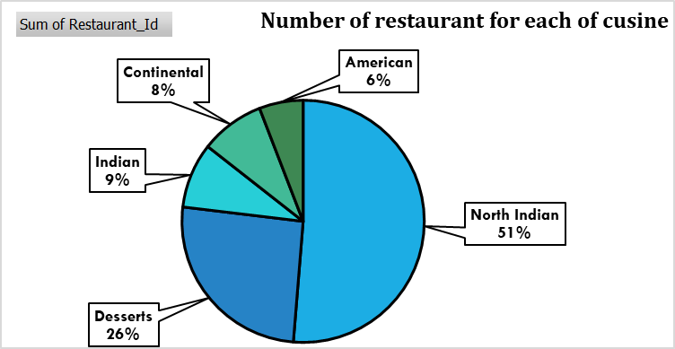
NUMBER OF RESTAURANT FOR EACH OF CUISINE
1. North Indian 2. Desserts 3. Indian

Slide 11
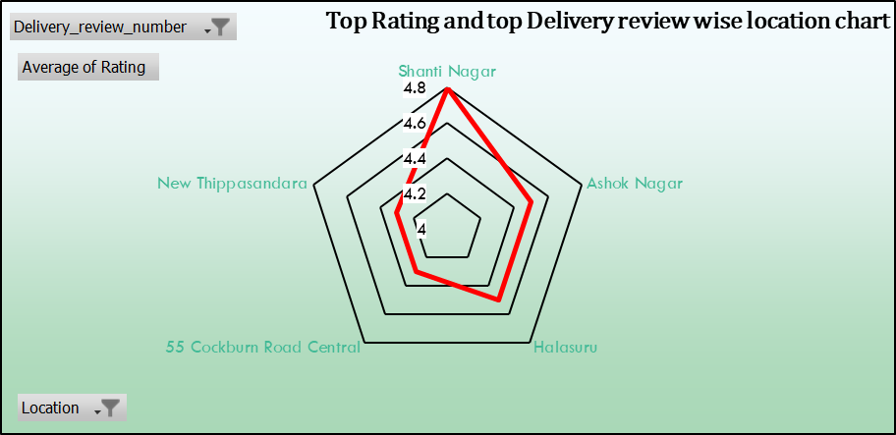
BEST LOCATION TO OPEN A RESTAURANT
•The best location to open a restaurant is Shanti Nagar due to its great delivery views and also has the highest average ratings.
•High delivery views means there are more people in this area, and the total number of restaurants is also not high.

Slide 12
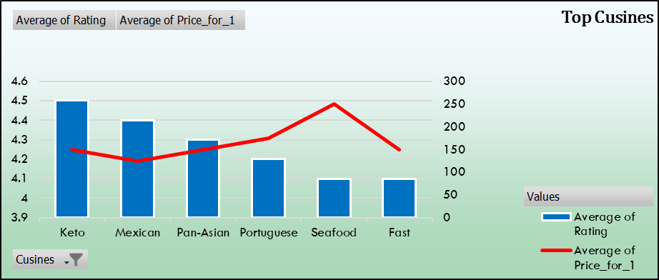
TOP CUISINES
We have selected several cuisines to be available in our restaurant, including Keto for 150 rupees, Mexican for 125 rupees, Pan-Asian for 150 rupees, and Portuguese for 175 rupees. The average price for our menu items is competitive and designed to cater to a variety of tastes and budgets.

Slide 13
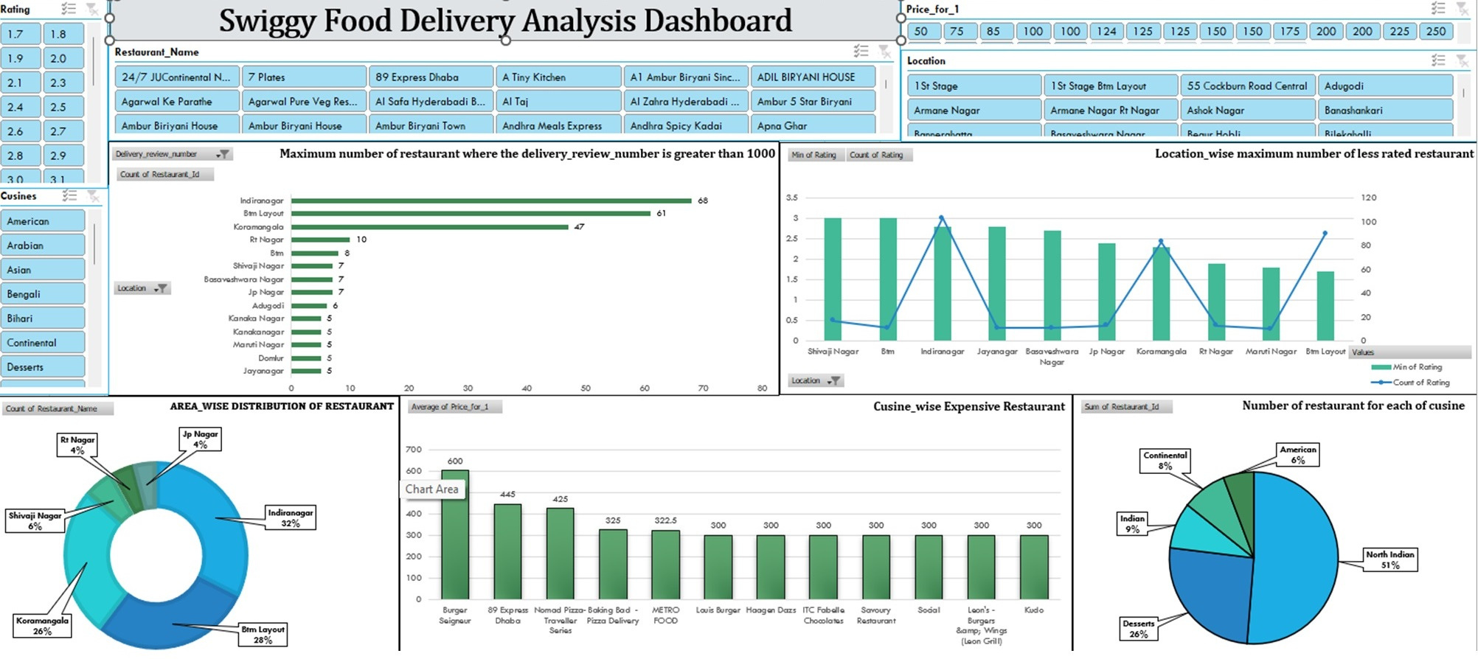
DASHBOARD

Slide 14
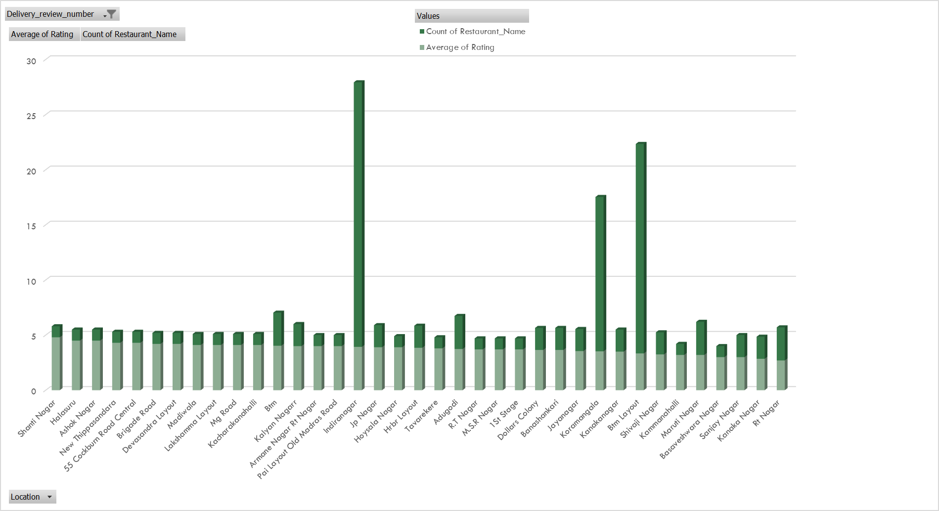
FUTURE SCOPE
•High-density areas such as Indiranagar, Koramangala, and BTM Layout have fewer highly-rated restaurants with high delivery reviews and fewer ratings.
• A remote kitchen can be a promising opportunity to take advantage of the high delivery review ratings and the scarcity of existing restaurants.
•This presents a potential opportunity for new restaurant openings.

Slide 15

CHALLENGES
Challenging Web Scraping:
Scraping Swiggy data proved to be a challenging task primarily due to the dynamic nature of the website.
Complex HTML Structure:
The website's HTML structure was intricate and complex, adding an extra layer of difficulty to the scraping process.
Efficient Time Management:
Managing time efficiently was essential to tackle the challenges effectively.

Slide 16
LEARNINGS
• Web scraping.
• Basic understanding of HTML Script.
• New Python library like Selenium and BeautifulSoup.
• Effective teamwork and time management strategies.

